Slide 1
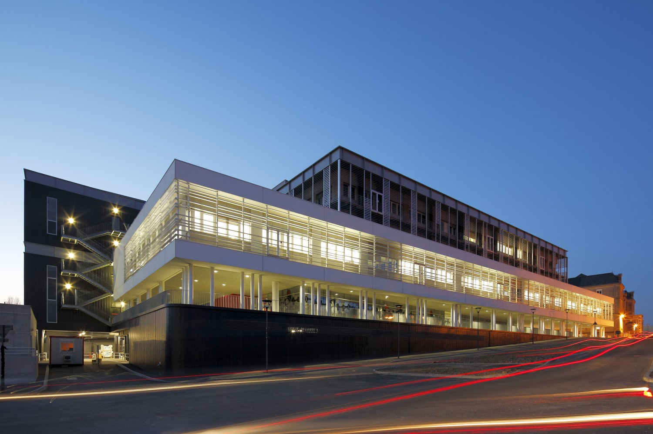
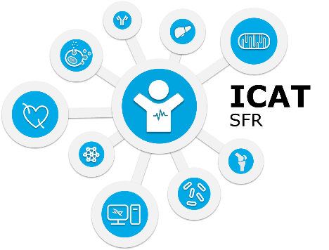
Rencontre MathSTIC - ICAT
15 novembre 2024

Slide 2
Principales missions
Renforcer et développer les plateformes technologiques + investissements
Elaborer et mettre en œuvre une politique scientifique
Faciliter les échanges et les collaborations scientifiques sur le site
Contribuer à l’animation scientifique
Favoriser et accompagner l’intégration de nouveaux chercheurs / nouvelles équipes
Soutenir le transfert industriel
Promouvoir les interactions entre recherche préclinique et clinique

Slide 3
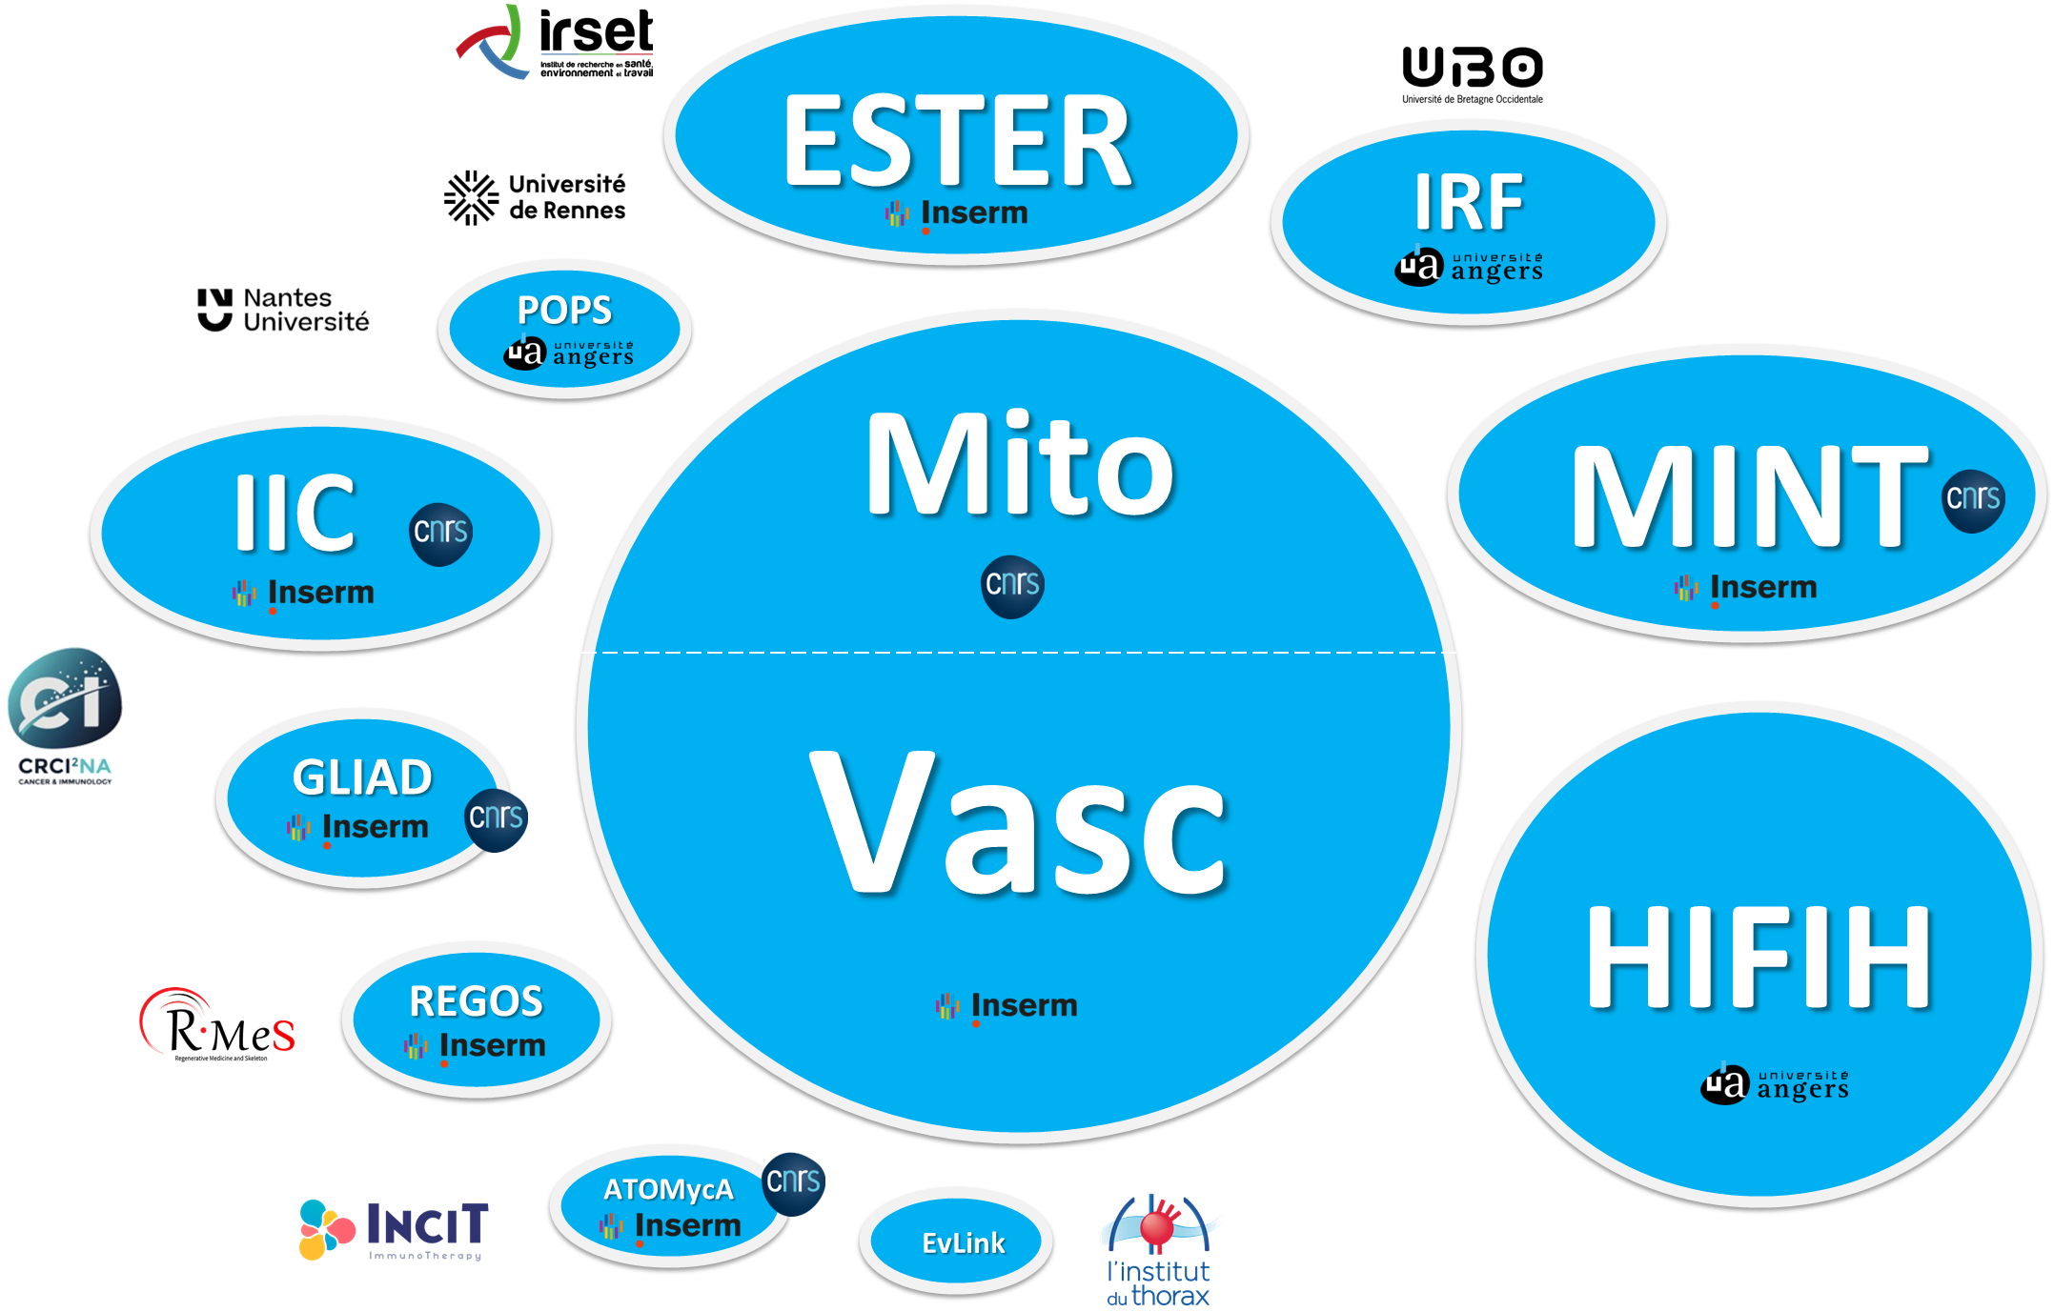
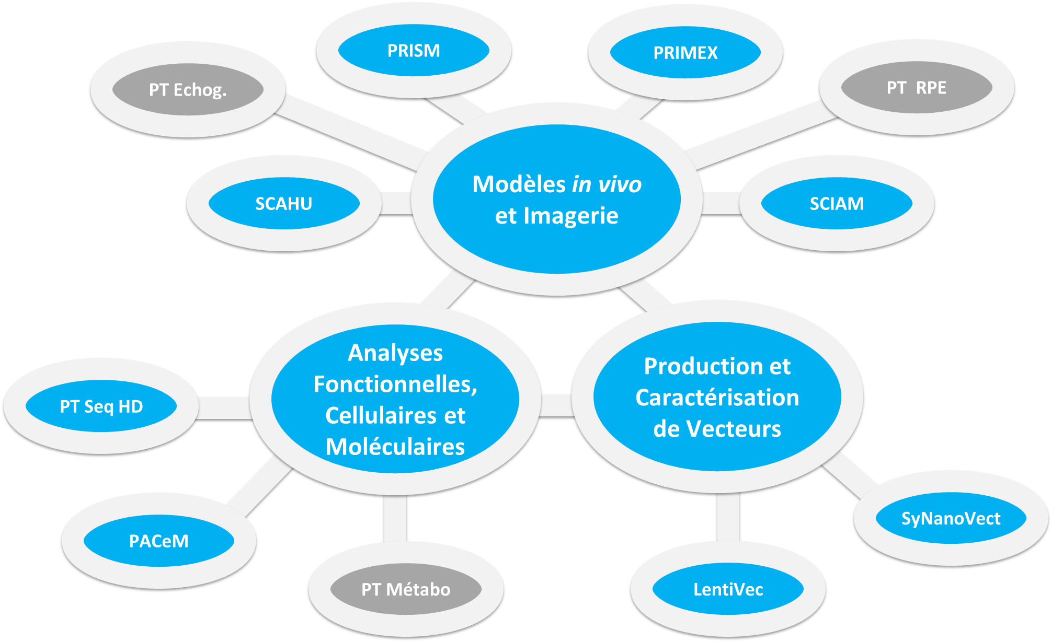
Chiffres clés…
11 Unités / Equipes
11 PFT / PT
228 chercheurs
97 ITA
+/- 90 doctorants
+/- 10 post-doctorants
Source EFFRECH janv. 2024

Slide 4
Unités et Equipes

Slide 5
Unités et Equipes
Name of the Unit |  | Head | Key words
Mitochodrial and Vascular Pathophysiology (MITOVASC) | Mitochondrial Pathophysiology (MitoLab) | Guy Lenaers | Mitochondria, Rare genetic diseases, Neurology, Ophthalmology
 | Cardiovascular Metabolism (CarMe) | Daniel Henrion | Cardiology, Vascular Physiology, Pharmacology, Toxicology
Hemodynamics, Fibrosis Interaction, and Hepatic Tumor Invasiveness (HIFIH) |  | Jérôme Boursier | Liver metabolism, Microbiota, Cancer
Translational Micro and Nanomedecines (MINT) |  | Patrick Saulnier | Vectorization, Lipid nanoparticles, Microfluidics, Pharmacology
Research Institute in Health, Environmental and Occupational Sciences (IRSET) | Team “Epidemiology of Occupational Heath and Ergonomy” (ESTER) | Yves Roquelaure | Ergonomics, Musculoskeletal disorders
Immunology and New Concept in Immunotherapy (INCIT) | Team “Buruli Ulcer” (ATOMYCA) | Estelle Marion | Buruli Ulcer, Mycobacteria, One Health
Fungal Respiratory Infections (FRI) |  | Nicolas Papon | Fungal infections, Multi-omics, Natural product bioengineering
Prevention, organisation and primary care (POPS) |  | Aline Ramond-Roquin | Primary care, Identification of patient at risk
Research Center in Cancer and integrated Immunology Nantes-Angers (CRCI2NA) | Team “Innate Immunity and Cancer” (I²C) | Yves Delneste | Immunology, Macrophages, Cancer
 | Team “Design and application of innovative loco-regional Treatments in Glioblastoma” (GLIAD) | Emmanuel Garcion | Glioblastoma, Radiotherapy
Regenerative Medicine and Skeleton (RMeS) | Team “Bone Regeneration” (REGOS) | Guillaume Mabilleau | Bone regeneration, Bone quality

Slide 6
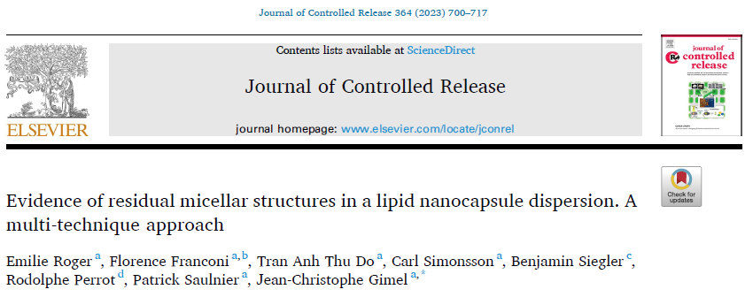
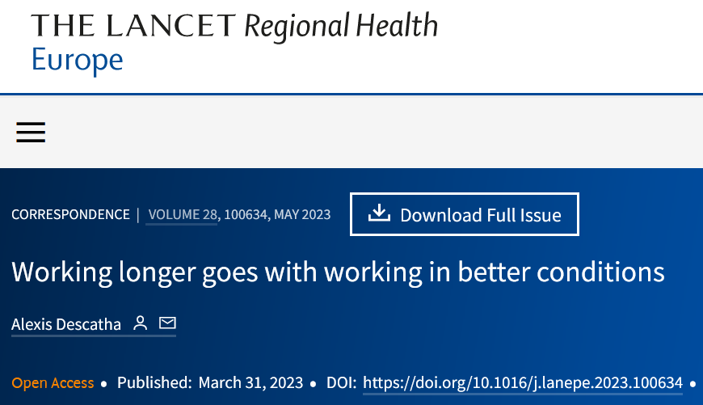
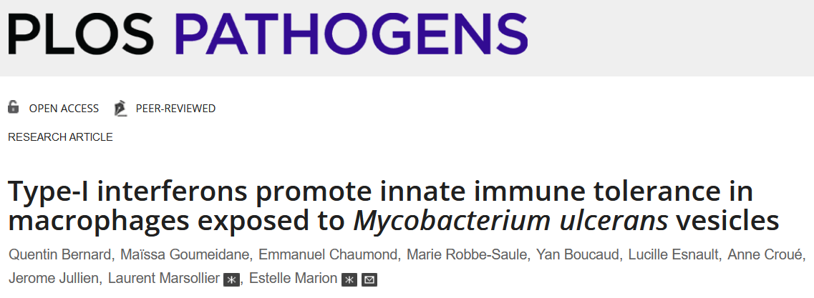
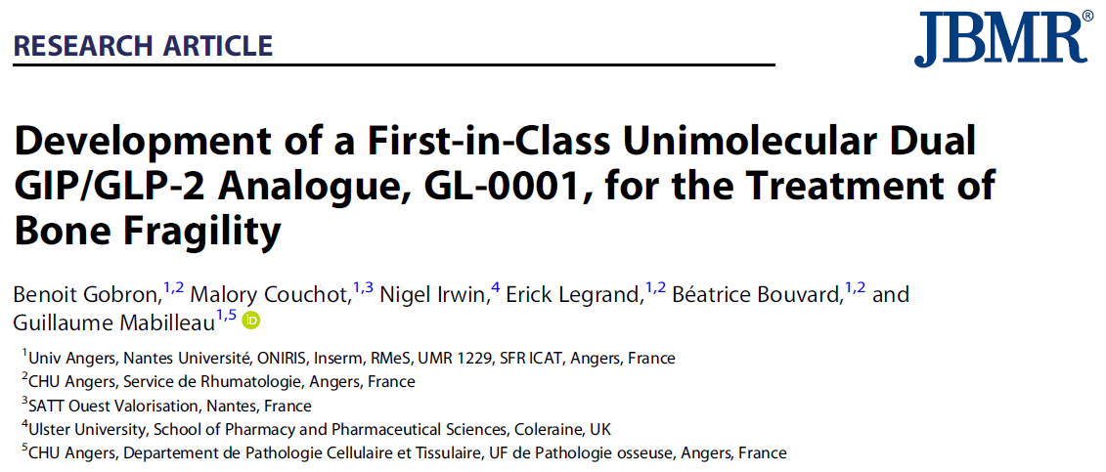
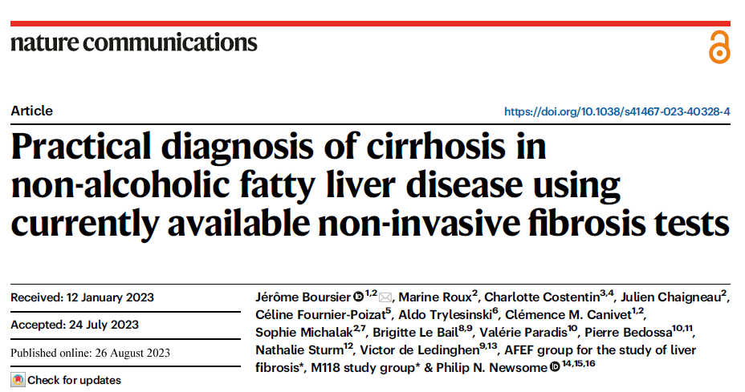
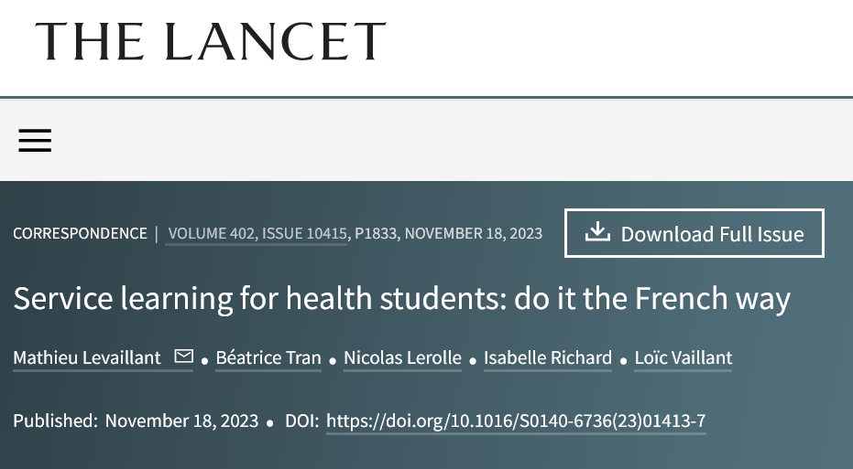
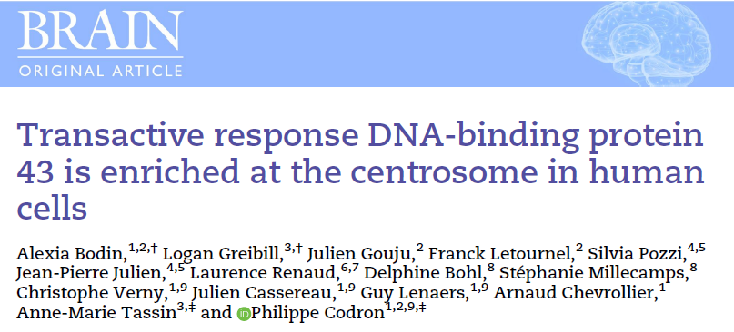
Des articles de hauts rangs

Slide 7
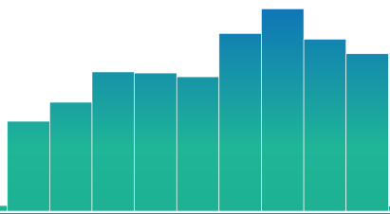
Production et classement
400-700 publications / an
Shangaï : 401-500 en « Clinical medicine »
348 395 434 421 386 640 731 679 565
2015 2016 2017 2018 2019 2020 2021 2022 2023

Slide 8
Website

Slide 9
Follow us !

